Slide 1

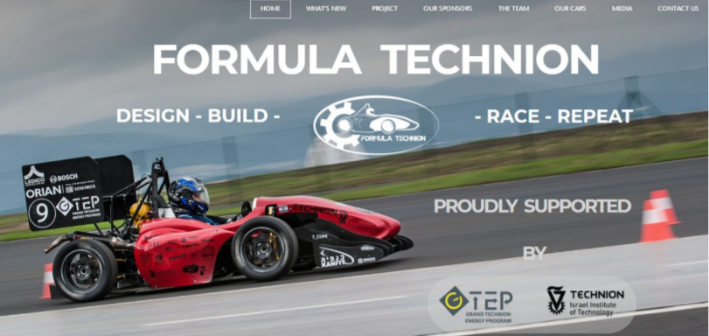
Final Presentation
SLAM for Formula Driverless
Students: Lital Guy, Maxim Aslyansky
Supervisors: Eli Appelboim, Israel Berger
Context: Project B
Semester: Winter, 2019
Date: 02/04/2019

Slide 2
Presentation Outline
Introduction and Prior Work
Our Setup and System Considerations
LIDAR Perception and LIDAR SLAM
Visual Cone Detection
Visual SLAM
Building Cone Map
Conclusions and Future Work

Slide 3
Project overview
Formula Student is a student engineering competition where student teams from around the world design, build, test, and race a small-scale formula style racing car. In 2017 Driverless competition was added.
Our contribution to the team:
Reconstruct the race track and estimate the vehicle position on the map while driving (SLAM)

Slide 4
Project Goal
Mapping is crucial to achieve high speed
During the first loop environment map is built
Allows to significantly improve speed by planning beforehand
Main challenges
The algorithm must run in real time
SLAM should be robust to fast motions and tracking failures
Sunlight, uneven road conditions, missing cones

Slide 5
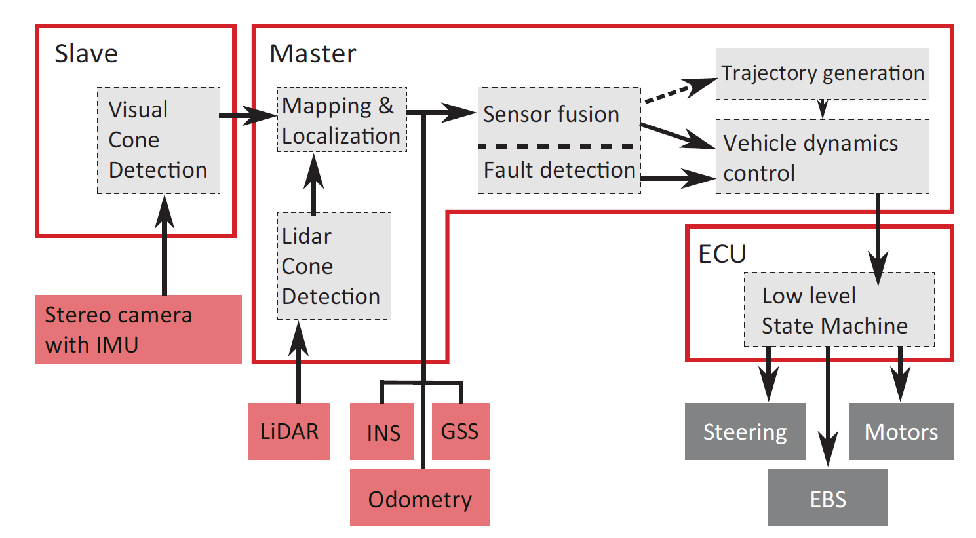
Background and Prior Work
AMZ Driverless
Two SLAM pipelines: - visual SLAM (+cones) - LIDAR SLAM (cones only)
Fused by Kalman Filter
Effective path planning
AMZ Driverless pipeline

Slide 6
System Overview
Visual Cone Detection
Visual Inertial Odometry (ROVIO)
Visual Inertial SLAM (ORB-SLAM 2)
Sensor Fusion
Map Fusion
Position Estimate
Path Planning
Vehicle Control
Fault Detection
Camera IMU
Point-Cloud Cone
Detection
LIDAR
Landmark
based
SLAM
LIDAR IMU
Data
Source
Done, Needs to be Checked
Our
Task
Future
Work/TBD

Slide 7
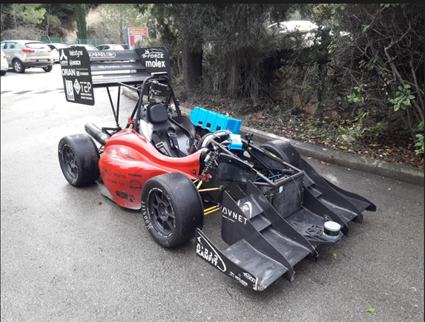
Our setup
ROS Kinetic and Ubuntu 16.06
Our hardware:
ZED stereo camera
Velodyne VLP-16 LIDAR
Jetson TX-1 embedded PC
WIFI for remote control
GoPro
racing car with the sensors

Slide 8
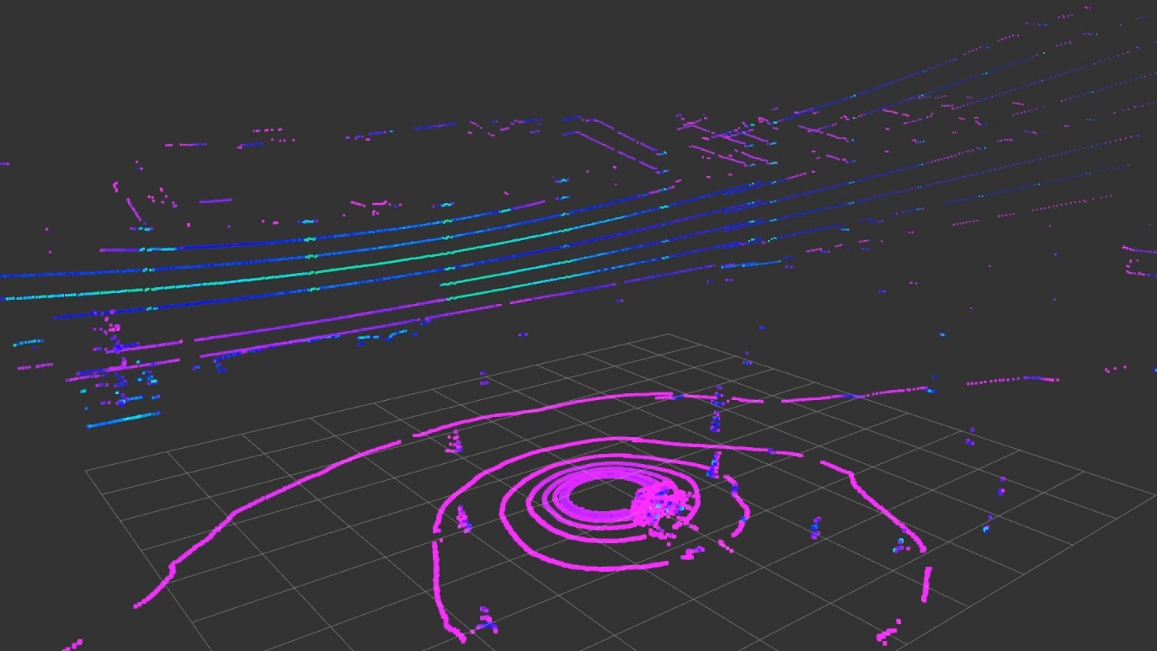
LIDAR perception and SLAM
LIDAR provides great accuracy, robustness and range
When placed correctly, it is especially useful for cone detection
a LIDAR scan

Slide 9
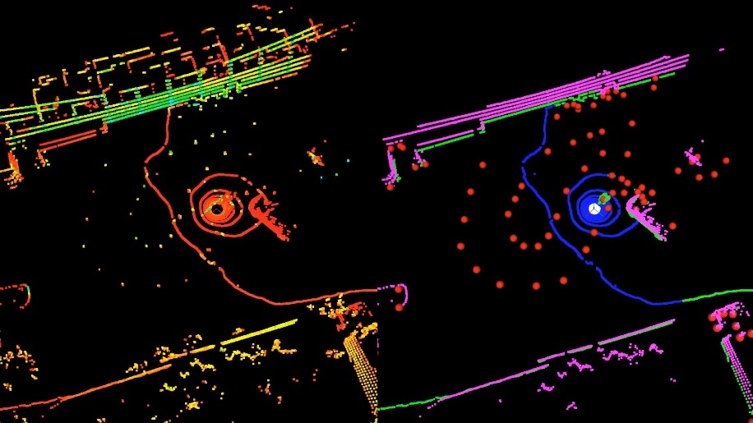
LIDAR Cone Detection
Steps of the algorithm
Remove distant points
Use RANSAC to detect the ground plane
Filter all points based on distance to ground
Apply Euclidean clustering on the points left
Filter clusters by size and extract centroids
Further filtering needed (spatial or temporal) to remove outliers
Implemented using PCL library and ROS
Input point cloud
Segmentation
color represents LIDAR intensity
cone clusters, ground points, too high, everything else

Slide 10
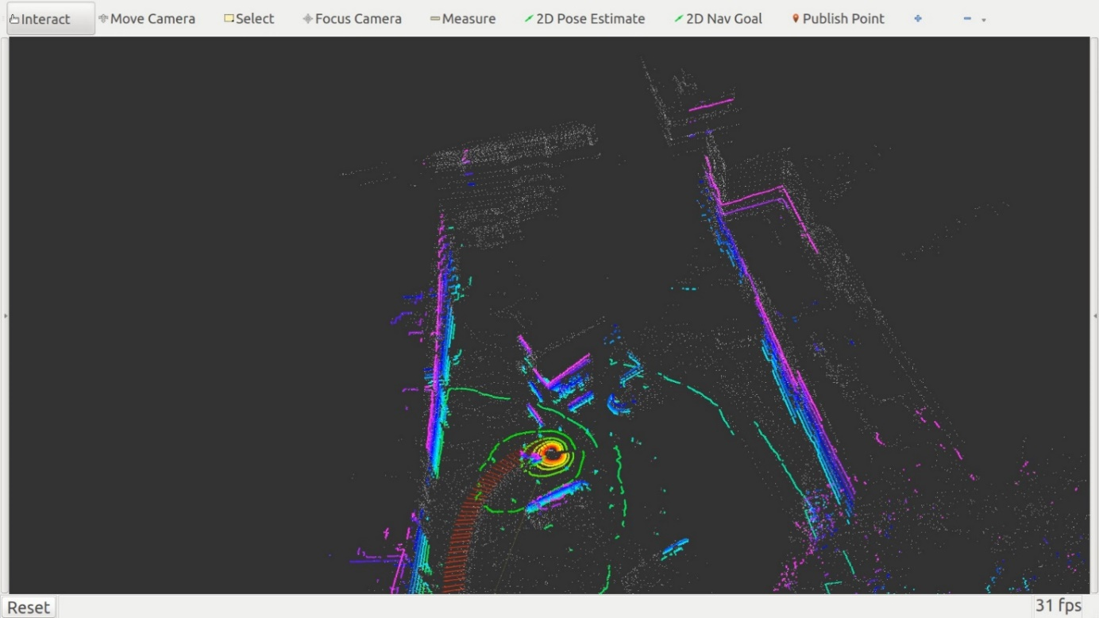
LIDAR SLAM
We tested several algorithms:
LOAM, HDL Graph SLAM LeGO-LOAM, Cartographer
None of them was good enough
Probably due to:
High speed, uncompensated ego-motion, not enough features for alignment (ICP)
Frame from LOAM map: current frame, map, vehicle pose

Slide 11
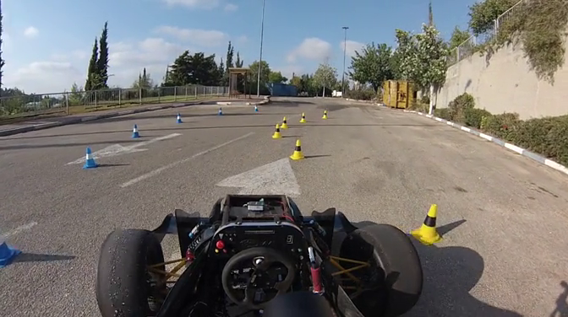
Visual-inertial perception and SLAM
Recently new CNN-based object detection algorithms were developed
Camera based SLAM has also became widely used in Robotics
a frame from onboard camera

Slide 12
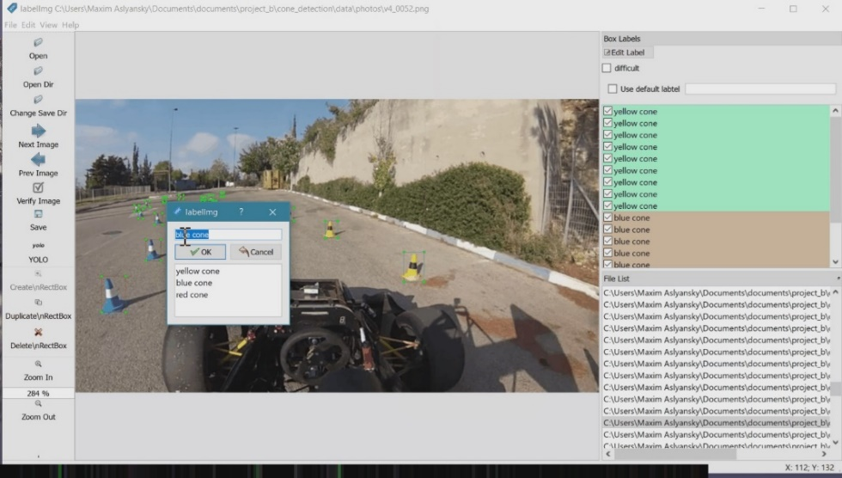
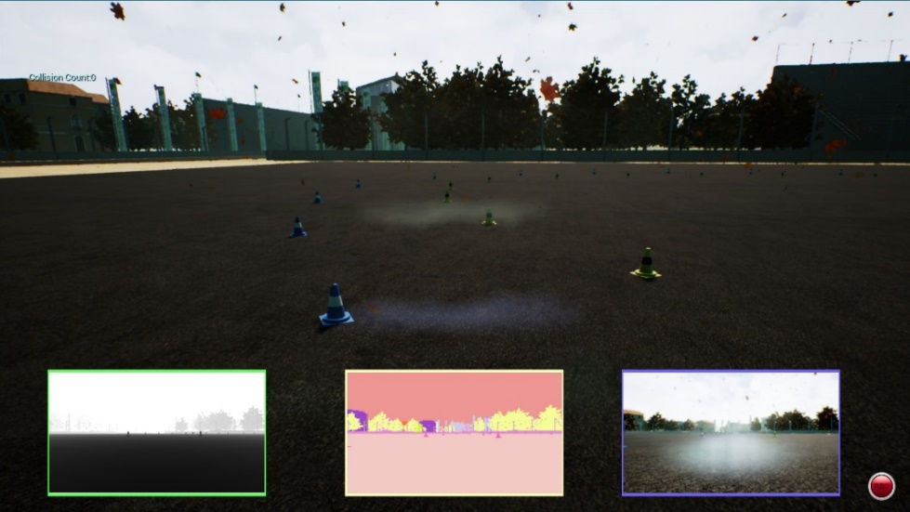
Dataset Visual Cone Detection
Prepared and annotated dataset with ~400 images and ~8k cones
Focused on dense annotation in real-world scenario
Then also used pre-trained network
Later started modifying AirSim simulator
Higher accuracy, weather, automatic
Ground-truth for depth prediction
LabelImg
AirSim

Slide 13
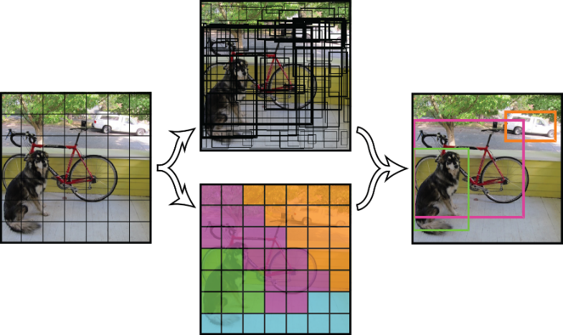
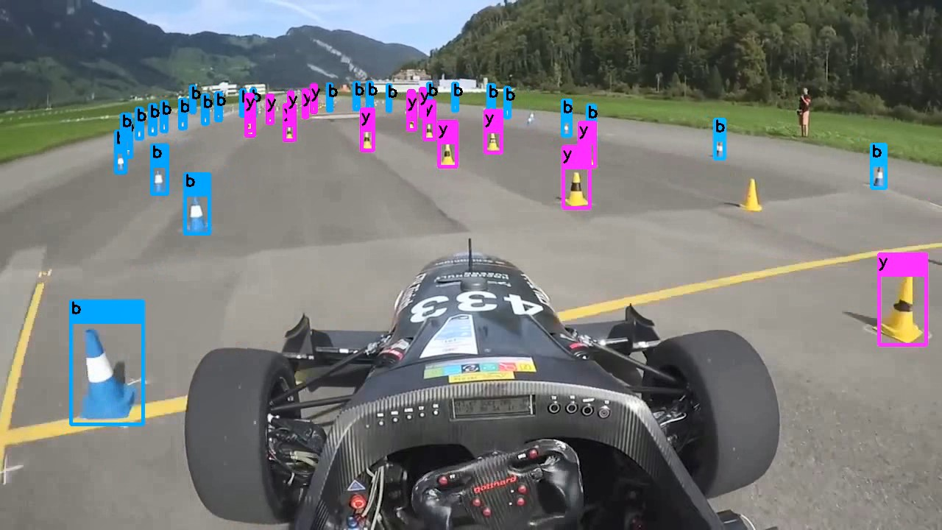
Visual Cone Detection
YOLOv3 detector implemented in Darknet
Fastest while being accurate enough
Optimized network architecture for accuracy
Added skip connections
Calibrated and added YOLO layers
Increased grid resolution
Trained on grayscale dataset
YOLO detector
our results

Slide 14
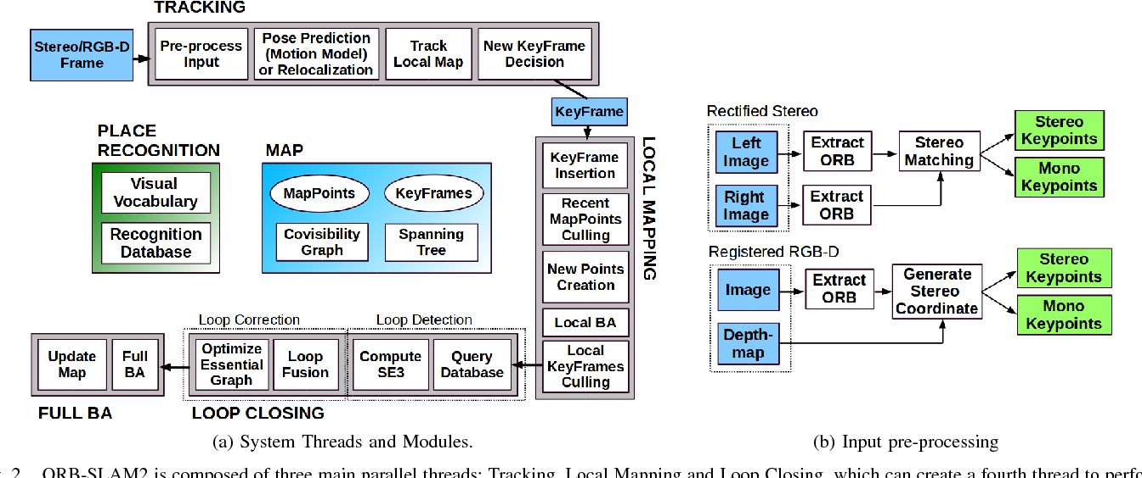
Visual SLAM
ORB-SLAM 2 is a very popular algorithm
Highly efficient and robust
Supports loop closure, localization mode
We also tested several extensions
SERVO is robust extension to ORB-SLAM 2 used by AMZ Driverless team
Benefits from ROVIO (robust visual-inertial odometry) initialization
ORB-SLAM 2 algorithm

Slide 15
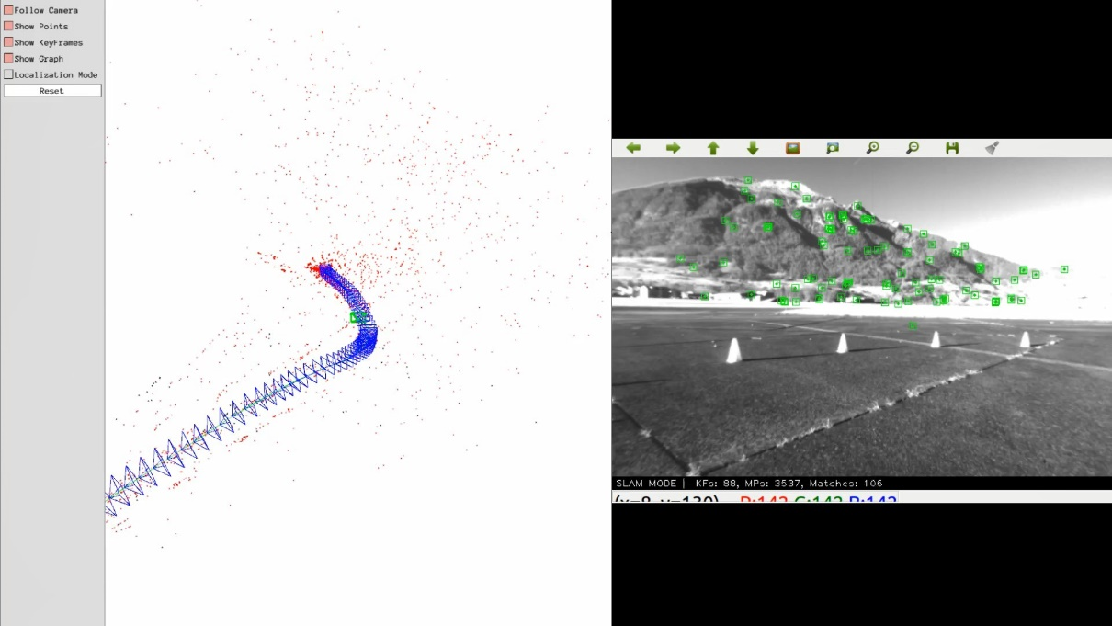
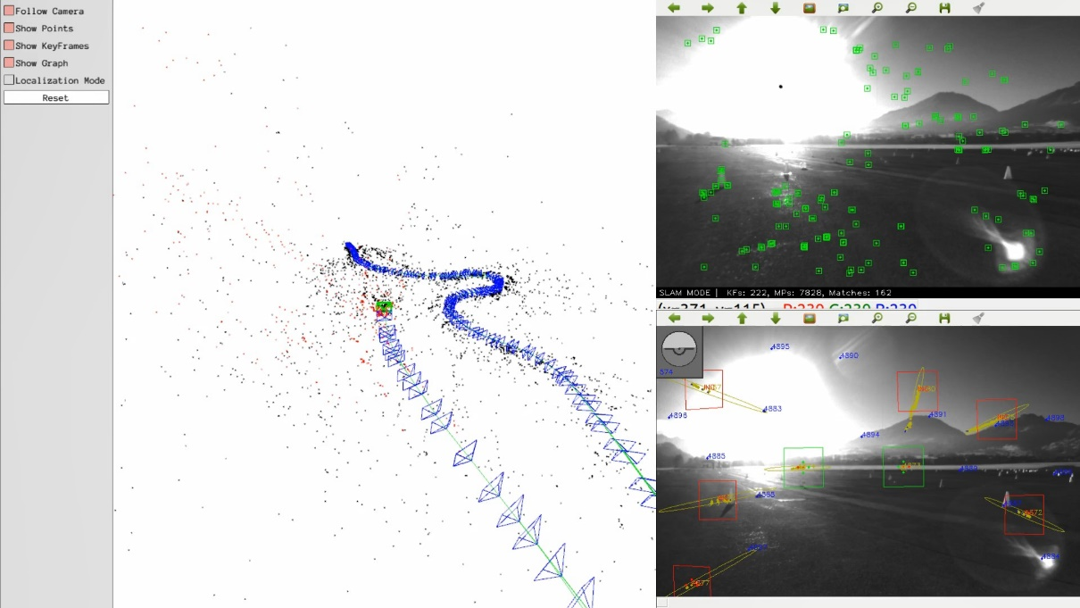
Visual SLAM - Results
Comparison:
ORBSLAM 2
SERVO

Slide 16
Adding Cones to the Map
Unlike AMZ we decided to integrate cones directly into ORBSLAM
Option A – Semantic SLAM
Mark all features that overlap with cone bounding boxes
Option B – cone feature
We’ve implemented this one
feature and object detections
Semantic SLAM
Our approach

Slide 17
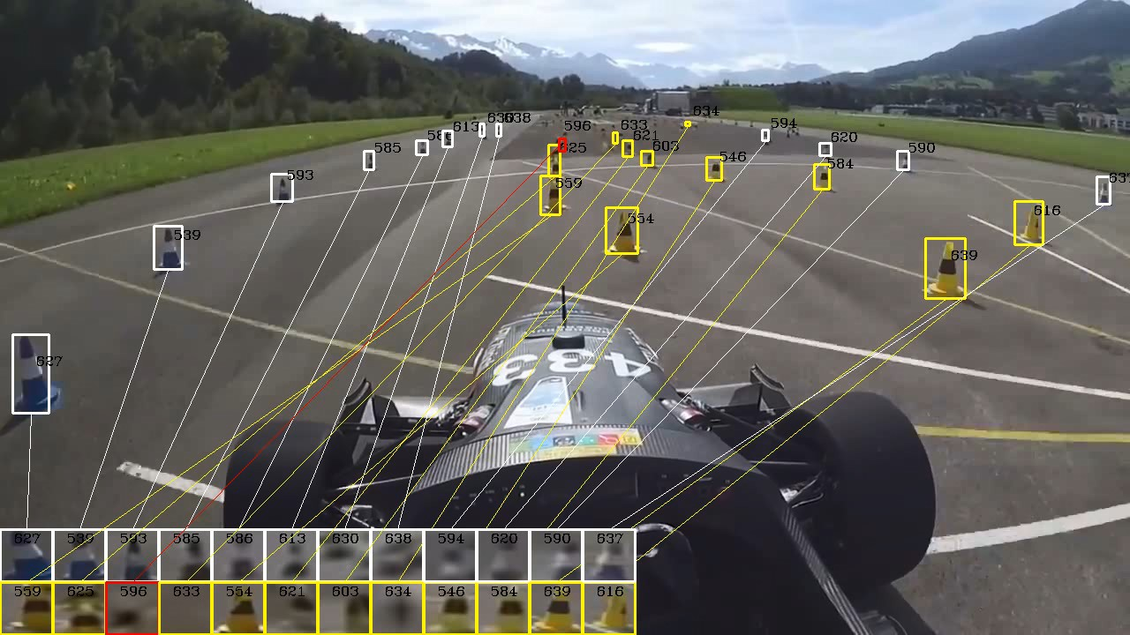
Cone Tracking
Inspired by the success of ROVIO we decided to implement cone tracking
Worked good in most cases but sometimes tracking was lost due to fast motion, especially near the edges
KLT object tracking

Slide 18
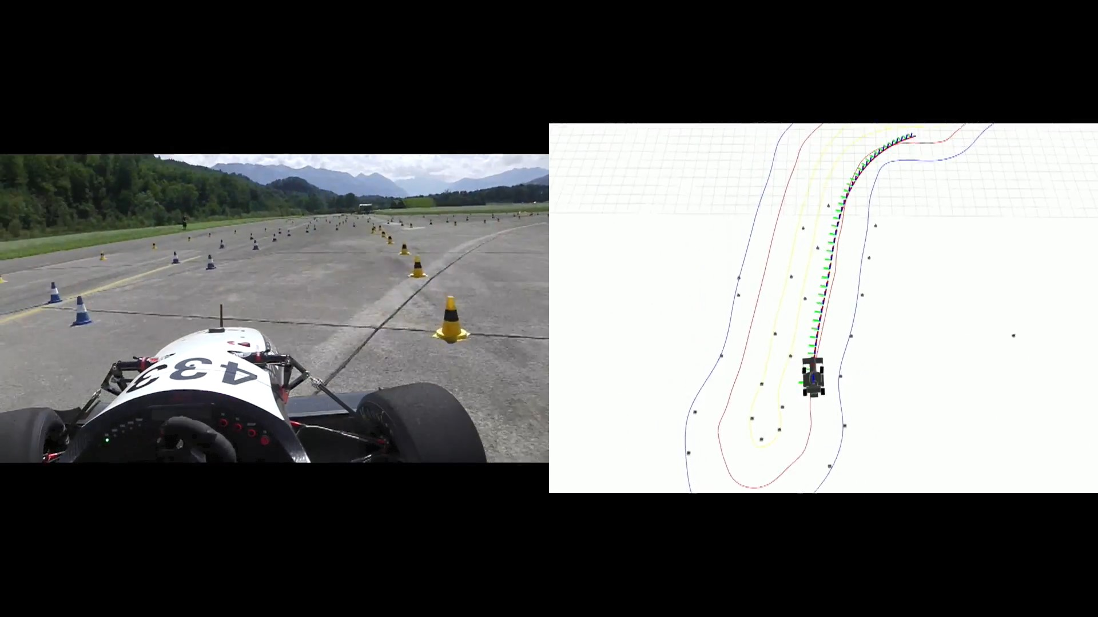

Conclusions and Future work
We developed several crucial algorithms with emphasis on high accuracy and performance
A lot of work to be done to achieve final working solution
AMZ demo
reconstructed track and path

Slide 19
Conclusions
LIDAR SLAM
cone detection algorithm is fast and robust but needs some refinement
existing SLAM algorithms performed poorly, custom solution is needed
Visual Cone Detection
our fine-tuned network achieved better accuracy compared to the competition (subjectively)
we believe the network can be further improved with synthetic data and extended with depth prediction
Visual SLAM
SERVO was more robust on provided data but needs to be tested on our data
developed algorithm for cone tracking (which would benefit from depth from the network and IMU)

Slide 20
Future Work
Data and Equipment Availability
LIDAR should be placed better (higher) and calibrated with camera
Need for a calibrated stereo rig with IMU
Better Cone Detection Dataset and Network
Use AirSim: diverse and accurate data, depth prediction and modify the network accordingly
Add depth and IMU information to improve tracking (similarly to ROVIO)
Integrating the Pipelines
Option A: Finish our work, Implement Kalman Filter and FastSLAM/g2o-based similarly to AMZ
Option B: Develop robust fusion of LIDAR and camera data and use single custom SLAM algorithm

Slide 21
References
Miguel I. Valls, Hubertus F.C. Hendrikx , Victor J.F. Reijgwart, Fabio V. Meier, Inkyu Sa, Renaud Dube, Abel Gawel, Mathias B ´ urki, and Roland Siegwart. “Design of an Autonomous Racecar: Perception, State Estimation and System Integration” International Conference on Robotics and Automation (2018)
Nikhil Bharadwaj Gosala, Andreas Bühler, Manish Prajapat, Claas Ehmke, Mehak Gupta, Ramya Sivanesan, Abel Gawel, Mark Pfeiffer, Mathias Bürki, Inkyu Sa, Renaud Dubé, Roland Siegwart. “Redundant Perception and State Estimation for Reliable Autonomous Racing”. International Conference on Robotics and Automation (2019)
Raul Mur-Artal and Juan D. Tardos. “ORB-SLAM2: an Open-Source SLAM System for Monocular, Stereo and RGB-D Cameras” IEEE Transactions on Robotics (2017)
Joseph Redmon, Ali Farhadi . “YOLOv3: An Incremental Improvement”. Computer Vision and Pattern Recognition (2018)

Slide 22

Thanks!
Questions?

